Slide 1
Essential Pain Management
EPM UK

Slide 2
Introduction
1.1

Slide 3
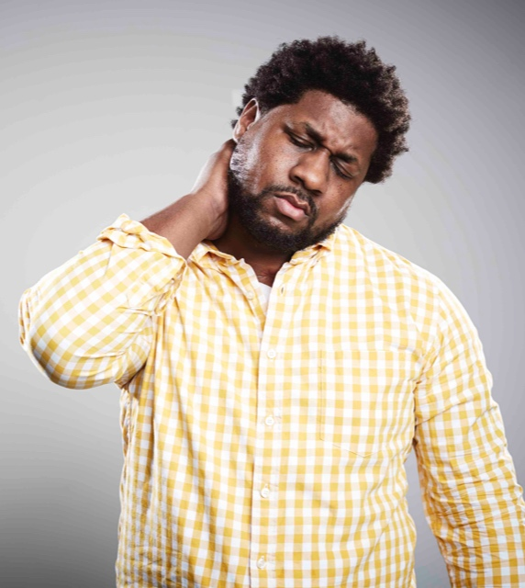
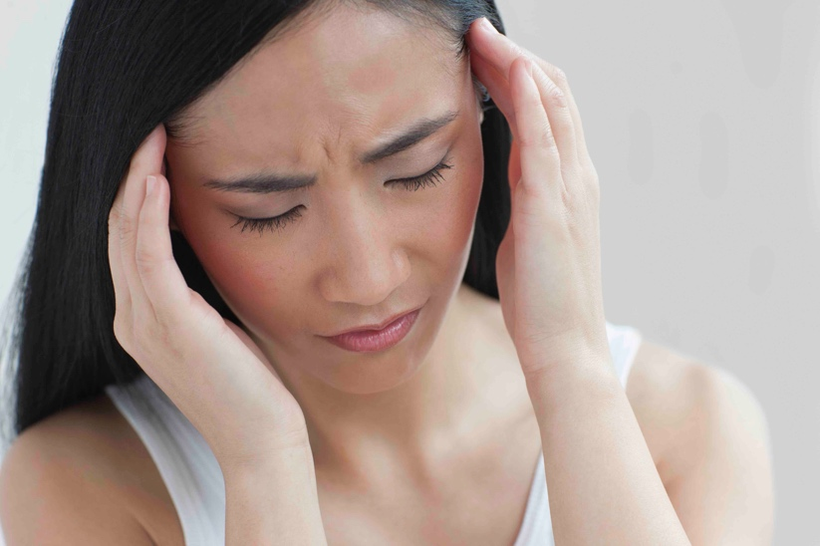
Why EPM?
1.2

Slide 4
Why EPM?
Pain is common.
Pain is often poorly managed.
We need a better system.
1.3

Slide 5
Overall EPM Aims
Better recognition
Better assessment
Better treatment
1.4

Slide 6
Workshop Objectives
You will be able to:
Recognize pain
  Define pain
  List benefits of treating pain
Assess pain
  Measure severity
  Classify pain type
  Assess other factors
1.5

Slide 7
Workshop Objectives
You will be able to:
Treat pain
  List non-pharmacological treatments
  List pharmacological treatments
1.6

Slide 8
EPM Lite Plan
Short, interactive lectures
Case discussions
1.7

Slide 9
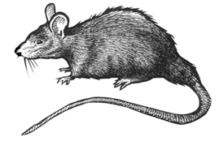
Untreated Pain
1.8

Slide 10
Untreated Pain
Often hidden (not recognized)
Causes a lot of suffering
But … can often be treated simply and cheaply
1.9

Slide 11
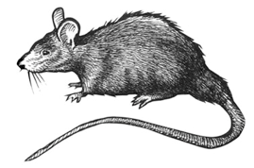
RAT System
Recognize
Assess
Treat
1.10

Slide 12
Recognize
Does the patient have pain?
Do other people know the patient has pain?
R2
1.11

Slide 13
Assess
How severe is the pain?
What type of pain is it?
Are there other factors?
A4
1.12

Slide 14
Treat
What non-pharmacological treatments can I use?
What pharmacological treatments can I use?
A4
1.13

Slide 15
?
1.14

Slide 16
Introduction
Summary
Pain is common.
Pain is often poorly treated.
We need a better system.
RAT provides this system.
1.15

Slide 17
Recognize
Assess
Treat
R1
1.7

Slide 18
Recognize
Does the patient have pain?
Do other people know the patient has pain?
The next lecture will cover:
  The definition of pain
  The benefits of treating pain
R
A
T
R2

Slide 19
What is Pain & Why Treat It?
R
A
T
2.1

Slide 20
What is Pain & Why Treat It?
Objectives
R
You will be able to:
Define pain
List the benefits of treating pain
A
T
2.2

Slide 21
Group Discussion
Think of a patient who has or had pain.
How did he or she describe the pain?
What were the benefits of treating his or her pain?
R
A
T
2.3

Slide 22

Does this person have pain?
R
A
T
2.4

Slide 23
What is Pain?
International Association for the Study of Pain (IASP)
  Pain is ‘an unpleasant sensory and emotional experience associated with actual or potential tissue damage, or described in terms of such damage’.
Are there any other definitions?
R
A
T
2.5

Slide 24
What is Pain?
R
Pain is unpleasant.
Emotions are important.
The cause is not always visible.
‘Pain is what the patient says hurts.’
A
T
2.6

Slide 25

Does this person have pain?
R
A
T
2.7

Slide 26
Benefits of Treating Pain
R
For the patient
  Physical
    Better sleep, improved appetite
    Fewer medical complications
    (e.g. heart attack, pneumonia)
  Psychological
    Reduced suffering
    Less depression, anxiety
A
T
2.8

Slide 27
Benefits of Treating Pain
R
For the family
  Improved function as part of the family
  (e.g. as a father / mother)
  Able to keep working
For society
  Reduced health costs
  (e.g. shorter hospital stay)
  Able to contribute to the community
A
T
2.9

Slide 28

What are the benefits for this child?
R
A
T
2.10

Slide 29
?
R
A
T
2.11

Slide 30
What is Pain & Why Treat It?
Summary
R
Pain is an unpleasant sensory and emotional experience.
Pain is subjective – ask the patient!
Treating pain has many benefits:
  For the patient
  For the family
  For society
A
T
2.12

Slide 31
Recognize
Assess
Treat
A1
1.7

Slide 32
Assess
R
How severe is the pain?
What type of pain is it?
Are there other factors?
A
T
A2

Slide 33
Assess
R
How severe is the pain?
  What is the pain score?
  How is the pain affecting the patient?
A
T
A3

Slide 34
Assess
R
What is the pain type?
  Acute or chronic?
  Cancer or non-cancer?
  Nociceptive or neuropathic?
A
T
A4

Slide 35
Assess
R
Are there other factors?
  Physical?
  Psychological?
A
T
A5

Slide 36
Assess
R
The next lectures will cover:
  Assessment of severity
  Classification of pain
  Underlying physiology and pathology
A
T
A6

Slide 37
Assessment of Severity
R
A
T
3.1

Slide 38
Assessment of Severity
Objectives
R
You will be able to:
Understand the reasons for assessing severity
Use different methods to assess severity
A
T
3.2

Slide 39
Assessment of Severity
R
Guides choice of treatment
Measures response to treatment
‘Pain is the 5th vital sign.’
  Measure and record severity
A
T
3.3

Slide 40
Assessment of Severity
R
What is the pain score?
  At rest?
  With movement?
How is the pain affecting the patient?
  Can the patient move, cough?
  Can the patient work?
A
T
3.4

Slide 41
Methods
R
Verbal Rating Scale
  Mild, moderate, severe
  0 (no pain) to 10 (worst pain imaginable)
Visual
  Visual Analogue Scale (VAS)
  Faces Pain Scale (FPS)
Other more specialised methods
A
T
3.5

Slide 42
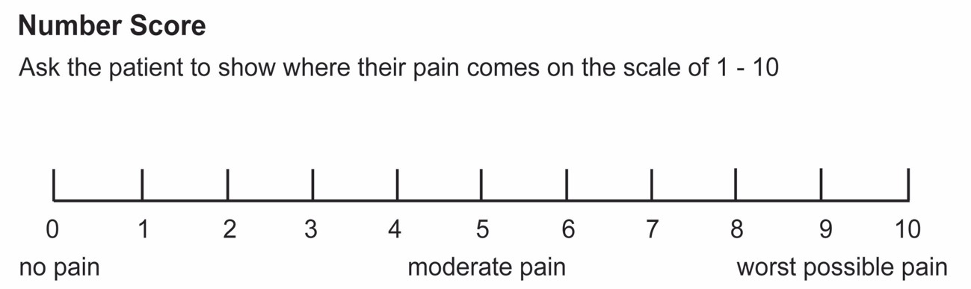
Visual Analogue Scale
R
Ask the patient to show what his/her pain is
on a scale of 0 to 10.
A
T
3.6

Slide 43
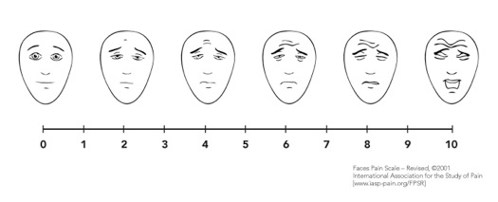
Faces Pain Scale
R
A
T
3.7

Slide 44
?
R
A
T
3.8

Slide 45
Assessment of Severity
Summary
R
Assessment of severity guides treatment and measures response.
Common methods include:
  Verbal Rating Scale
  Visual Analogue Scale
  Faces Pain Scale
A
T
3.9

Slide 46
Classification of Pain
R
A
T
4.1

Slide 47
Classification of Pain
Objectives
R
You will be able to:
Classify types of pain
Give examples of types of pain
Understand that treatment depends on the pain type
A
T
4.2

Slide 48
Classification of Pain
R
Not all pain is the same!
Three main questions:
  How long has the patient had pain?
  What is the cause?
  What is the pain mechanism?
A
T
4.3

Slide 49
Classification of Pain
R
Duration | Acute Chronic
Cause | Cancer Non-cancer
Mechanism | Nociceptive (physiological) Neuropathic (pathological)
A
T
4.4

Slide 50
Acute versus Chronic
Acute
  Pain of recent onset and probable limited duration
Chronic
  Pain lasting for more than 3 months
  Pain lasting after normal healing
  Sometimes no identifiable cause
R
A
T
4.5

Slide 51
Cancer versus Non-Cancer
R
Need one of sick patient / cancer
A
T
4.6

Slide 52
Cancer versus Non-Cancer
R
Cancer pain
  Progressive
  May be mixture of acute and chronic
Non-cancer pain
  Many different causes
  Acute or chronic
  Can you give examples of non-cancer pain?
A
T
4.7

Slide 53
Nociceptive Pain
R
Obvious tissue injury or illness
Sometimes called physiological or inflammatory pain
Protective function
Description
  Sharp and/or dull
  Well localised
Can you give examples?
A
T
4.8

Slide 54
Neuropathic Pain
Caused by a lesion or disease of the sensory nervous system
Tissue injury may not be obvious
Does not have a protective function
Description
  Burning, shooting, pins and needles, or numbness
  Not well localised
Can you give examples?
R
A
T
4.9

Slide 55
Examples of Pain Types
R
A
T
4.10

Slide 56
Acute Non-Cancer Pain
R
Examples
  Fracture, appendicitis
Symptom of tissue injury or illness
Usually nociceptive
Occasionally neuropathic (e.g. sciatica)
A
T
4.11

Slide 57

How would you classify low back pain?
R
A
T
4.12

Slide 58
Chronic Non-Cancer Pain
Examples
  Chronic back pain, arthritis
Cause may not be obvious
Complex, may be mixed nociceptive and neuropathic
Different pharmacological treatments may be needed
R
A
T
4.13

Slide 59
Cancer Pain
Examples
  Uterine cervical cancer, breast cancer
  Metastases in bone
Features of acute and chronic pain
  May be acute on chronic
Often mixed nociceptive and neuropathic pain
Usually gets worse over time if untreated
R
A
T
4.14

Slide 60
?
R
A
T
4.15

Slide 61
Classification of Pain
Summary
R
Deciding on the type of pain is important
  Acute / chronic
  Cancer / non-cancer
  Nociceptive / neuropathic
Treatment depends on the pain type.
A
T
4.16

Slide 62
Pain Physiology and Pathology
R
A
T
5.1

Slide 63
Pain Physiology and Pathology
Objectives
R
You will be able to:
Understand normal pain physiology
  Nociceptive pathway
  Factors affecting pain perception
Understand the basis of neuropathic pain (pathology)
A
T
5.2

Slide 64
Why is pain physiology important?
Many factors affect how we feel pain.
  Psychological factors are very important.
Different treatments work on different parts of the pathway.
  More than one treatment is usually needed.
R
A
T
5.3

Slide 65
Nociception and Pain
Nociception
  How pain signals get from the site of injury to the brain.
Pain
  How we perceive or feel pain.
Nociception is not the same as pain!
R
A
T
5.4

Slide 66

Is this man feeling pain?
R
A
T
5.5

Slide 67
Nociception is not the same as pain!
Nociception
R
Beliefs
e.g. religion
Other illnesses
e.g. cancer
A
Psychol. factors
e.g. anger, anxiety
Personality
T
Cultural issues
e.g. expectations
Social factors
e.g. family, work
Pain
What the patient says hurts.
What must be treated.
5.6

Slide 68
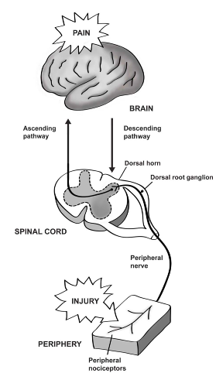
Physiology
R
4 steps:
  Periphery
  Spinal cord
  Brain
  Modulation
We will look at each step.
A
T
5.7

Slide 69
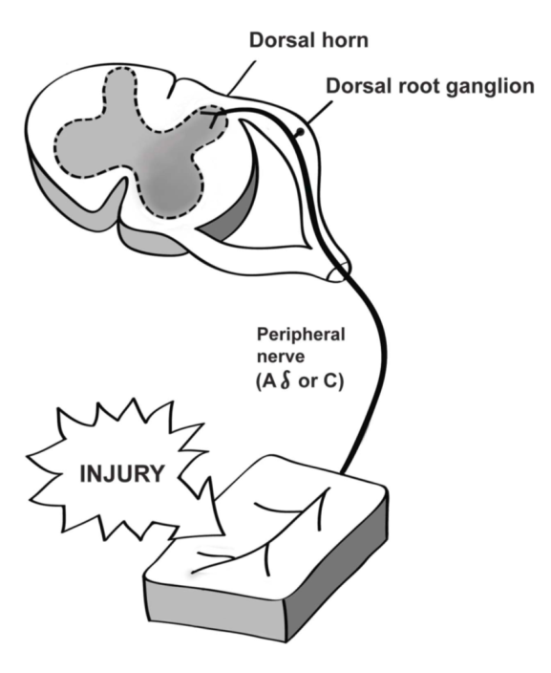
Periphery
Tissue injury
Release of chemicals
Stimulation of pain receptors (nociceptors)
Signal travels in Aδ or C nerve to spinal cord.
R
A
T
5.8

Slide 70
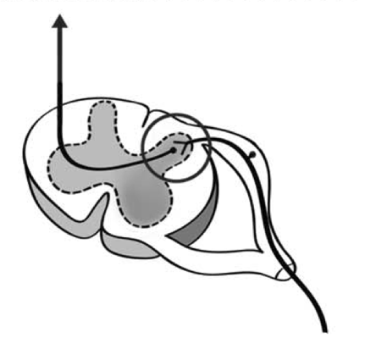
Spinal Cord
Dorsal horn is the first relay station.
Aδ or C nerve synapses (connects) with second order nerve.
Second order nerve travels up opposite side of spinal cord.
R
A
T
5.9

Slide 71
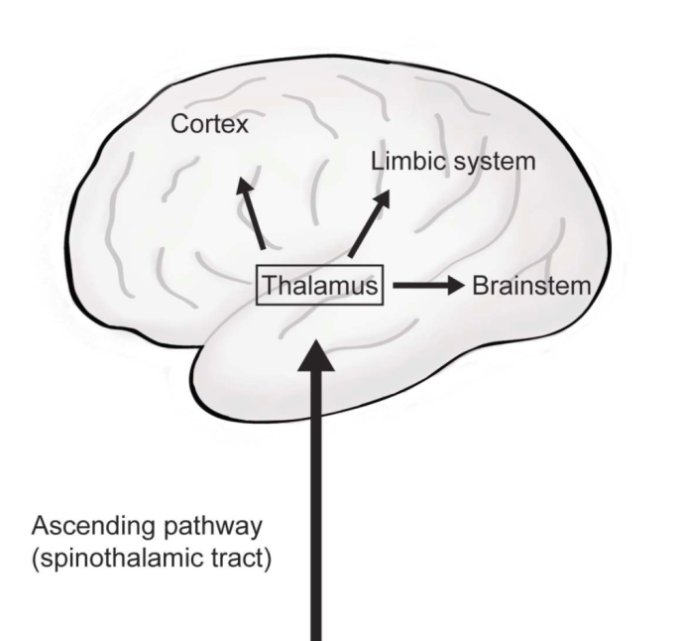
Brain
Thalamus is the second relay station.
Connections to many parts of the brain.
  Cortex
  Limbic system
  Brainstem
Pain perception occurs in the brain.
R
A
T
5.10

Slide 72
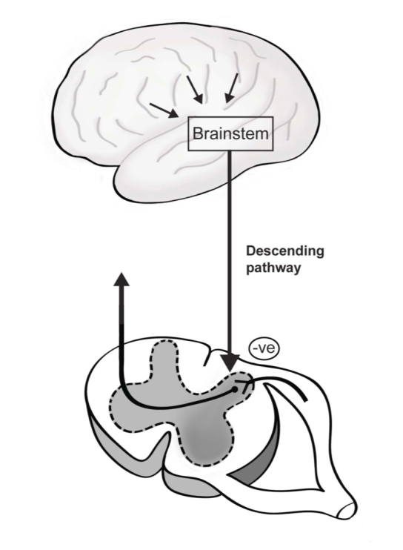
Modulation
Descending pathway from brain to dorsal horn.
Usually inhibits pain signals from the periphery.
R
A
T
5.11

Slide 73
Neuropathic Pain
Pathological pain
Abnormality of nociceptive pathway
  Peripheral nerves
  Spinal cord or brain
Needs different pharmacological treatments
How do patients describe their pain?
R
A
T
5.12

Slide 74
Neuropathic Pain - Mechanisms
Abnormal nerve tissue, e.g. amputation neuroma
Abnormal firing of pain nerves
Changes in chemical signalling in the dorsal horn
Abnormal nerve connections in the dorsal horn
Loss of normal inhibitory function
R
A
T
5.13

Slide 75
?
R
A
T
5.14

Slide 76
Pain Physiology and Pathology
Summary
R
Nociception is not the same as pain.
Physical and psychological factors affect how we feel pain.
Different treatments work on different parts of the nociceptive pathway.
Neuropathic pain needs different pharmacological treatments.
A
T
5.15

Slide 77
Recognize
Assess
Treat
T1
1.7

Slide 78
Treat
Non-pharmacological treatments?
Pharmacological treatments?
The next lectures will cover:
  Non-pharmacological and pharmacological treatments
  Pharmacology of common pain medications
R
A
T
T2

Slide 79
Pain Treatment Overview
R
A
T
6.1

Slide 80
Pain Treatment Overview
Objectives
R
You will be able to:
Describe the non-pharmacological and pharmacological treatments that are available
Classify pain treatments
Understand the role of placebo treatment
A
T
6.2

Slide 81
Group Discussion
Name at least 10 non-pharmacological treatments that can be used to treat pain.
Name at least 10 pharmacological treatments that can be used to treat pain.
R
A
T
6.3

Slide 82
Non-Pharmacological Treatments
R
Physical
  Rest, ice, compression, elevation
  Surgery
  Acupuncture, massage, physiotherapy
Psychological
  Explanation
  Reassurance
  Counselling
A
T
6.4

Slide 83
Pharmacological Treatments
Simple analgesics
  Paracetamol (acetaminophen)
  Anti-inflammatory medicines, e.g. ibuprofen
Opioids
  Mild, e.g. codeine, tramadol
  Strong, e.g. morphine, pethidine, oxycodone
R
A
T
6.5

Slide 84
Pharmacological Treatments
Other analgesics
  Tricyclic antidepressants, e.g. amitriptyline
  Anticonvulsants, e.g. carbamazepine, gabapentin
  Local anaesthetics
  Others, e.g. ketamine, clonidine
R
A
T
6.6

Slide 85
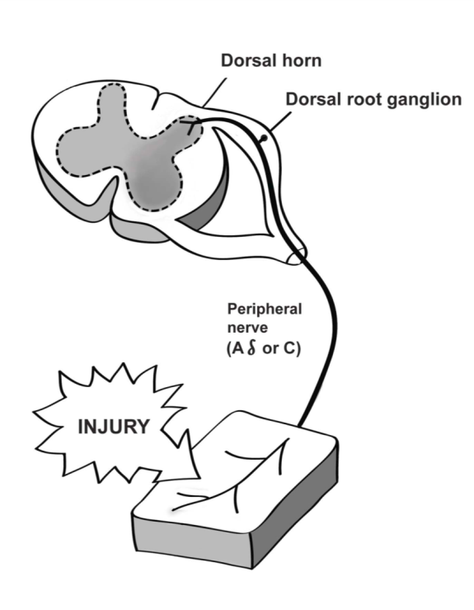
Treatments - Periphery
R
Non-pharm treatments
  Rest, ice, compression, elevation
Anti-inflammatory medicines
Local anaesthetics
A
T
6.7

Slide 86
Treatments - Spinal Cord
R
Non-pharm treatments
  Acupuncture, massage
Local anaesthetics
Opioids
Ketamine
A
T
6.8

Slide 87
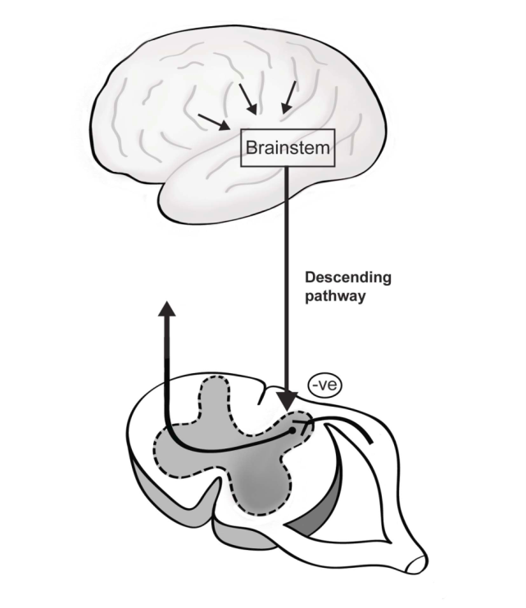
Treatments - Brain
R
Non-pharm treatments
  Psychological
Pharmacological treatments
  Paracetamol
  Opioids
  Amitriptyline
A
T
6.9

Slide 88
Group Discussion
R
What is a placebo treatment?
Is it helpful or unhelpful?
A
T
6.10

Slide 89
Placebo Treatment
Psychological factors are important.
If a placebo treatment works, this does not mean that the patient did not have pain or was telling lies!
R
A
T
6.11

Slide 90
?
R
A
T
6.12

Slide 91
Pain Treatment Overview
Summary
R
Both non-pharmacological and pharmacological treatments are important.
Different treatments work on different parts of the nociceptive pathway.
Pain medications can be classified into simple analgesics, opioids and other analgesics.
A
T
6.13

Slide 92
Pain Medications
R
A
T
7.1

Slide 93
Pain Medications
Objectives
R
You will be able to:
Outline broad principles of pharmacological treatment
Summarise the major advantages and disadvantages of important medications
Address concerns about opioid addiction
A
T
7.2

Slide 94
Broad Principles
R
This lecture:
  Gives a broad overview of pharmacological treatment in common situations
  Gives examples of medications
For more detail, including doses:
  Case discussions
  EPM manual and EPM app
A
T
7.3

Slide 95
Treatment of Cancer Pain
WHO Ladder*
Step 3
Severe pain
R
Step 2
Moderate pain
Use strong opioid
e.g. morphine
Continue simple analgesics
A
Use mild opioid
e.g. codeine, tramadol
Continue simple analgesics
Step 1
Mild pain
T
Use simple analgesics
Add other medications for neuropathic pain
e.g. amitriptyline, gabapentin
7.4
*Modified

Slide 96
WHO Ladder
Developed for cancer pain
Emphasises oral treatment
Treats nociceptive pain
May need other medications for neuropathic pain
Don’t forget non-pharmacological treatments!
R
A
T
7.5

Slide 97
Treatment of Acute Nociceptive Pain
Reverse WHO Ladder
R
Step 3
Severe pain
A
Use strong opioid
e.g. morphine
Also use simple analgesics
Step 2
Moderate pain
Use mild opioid
e.g. codeine, tramadol
Continue simple analgesics
T
Step 1
Mild pain
Continue simple analgesics
7.6

Slide 98
Reverse WHO Ladder
Mainly useful for severe acute nociceptive pain
  Trauma pain
  Post-operative pain
Start at the top and ‘step down the ladder’ as the pain improves.
R
A
T
7.7

Slide 99
Chronic, Non-Cancer Pain
Non-pharmacological treatments very important
May need treatment for neuropathic pain
  Antidepressants, e.g. amitriptyline
  Anticonvulsants, e.g. gabapentin
Opioids are usually not helpful and may cause harm.
R
A
T
7.8

Slide 100
Group Discussion*
R
Choose two medications from each class:
  Simple analgesics
  Opioids
  Other analgesics
For each medication, what are the:
  Indications?
  Advantages?
  Disadvantages?
A
T
7.9
*Optional, if time

Slide 101
Examples of Pain Medications
R
A
T
7.10

Slide 102
Paracetamol (Acetaminophen)
R
Indications
  Mild nociceptive pain
  Moderate to severe nociceptive pain
  (with other medications)
Advantages
  Cheap, safe
  PO, PR, IV
Disadvantages
  Liver damage in overdose
A
T
7.11

Slide 103
Ibuprofen
R
Indications
  Mild, moderate or severe nociceptive pain
Advantages
  Cheap
  Usually safe if given short-term
Disadvantages
  Gastric and renal side effects
  Interferes with blood clotting
A
T
7.12

Slide 104
Tramadol
Indications
  Nociceptive and neuropathic pain
Advantages
  Safe
  Useful for different pain types
  Can be used with morphine
Disadvantages
  Nausea and vomiting
  Confusion
R
A
T
7.13

Slide 105
Morphine 1
R
Indications
  Moderate to severe, acute, nociceptive pain
  Cancer pain
Advantages
  Very effective
  Cheap
  Usually safe
  PO, IV, IM, SC
A
T
7.14

Slide 106
Morphine 2
R
Disadvantages
  Nausea and vomiting
  Respiratory depression in high dose
  Constipation
  Misunderstandings about addiction
  Legal controls
A
T
7.15

Slide 107
Morphine Dosing
R
Oral dose is 2-3 times IV / IM / SC dose.
Why is this?
Tolerance
  Increased dose needed over time
  Very high doses may be needed in cancer treatment
A
T
7.16

Slide 108
Amitriptyline
R
Indication
  Neuropathic pain
Advantages
  Cheap
  Safe in low dose
  Also treats depression, poor sleep
Disadvantages
  Harmful in overdose
  Dry mouth, drowsiness
  Urinary retention
A
T
7.17

Slide 109
Gabapentin
R
Indication
  Neuropathic pain
Advantages
  Safe and effective
Disadvantages
  Drowsiness
  Dose needs to be increased slowly
A
T
7.18

Slide 110
Group Discussion
What is addiction?
How common is opioid addiction in patients with pain?
Would this stop you giving opioids to a patient who has pain?
R
A
T
7.19

Slide 111
Opioids and Addiction
Addiction – Three C’s
  Craving
  Loss of control
  Negative consequences
Addiction is very rare in acute pain and cancer pain.
Addiction may occur if strong opioids are used to treat chronic non-cancer pain.
R
A
T
7.20

Slide 112
?
R
A
T
7.21

Slide 113
Pain Medications
Summary
R
Pain can be treated with relatively cheap and safe medications.
Morphine is very effective for cancer pain and acute severe nociceptive pain.
In general, strong opioids should be avoided in chronic non-cancer pain.
A
T
7.22

Slide 114
Using the RAT System
R
A
T
8.1

Slide 115
Using the RAT System
Objectives
R
You will be able to:
Summarise the RAT system
Apply this system to different types of pain
Understand the importance of reassessment
A
T
8.2

Slide 116
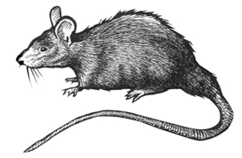
Using the RAT System
R
A
T
8.3

Slide 117
Using the RAT System
Recognize
Assess
  Severity?
  Type?
  Other factors?
Treat
  Non-pharmacological treatments
  Pharmacological treatments
R
A
T
8.4

Slide 118
Using the RAT System
Recognize
R
Does the patient have pain?
Do other people know the patient has pain?
A
T
8.5

Slide 119
Using the RAT System
Assess
R
How severe is the pain?
  Measure at rest
  Measure with movement
A
T
8.6

Slide 120
Using the RAT System
Assess
R
What type of pain is it?
  Acute or chronic?
  Cancer or non-cancer?
  Nociceptive or neuropathic?
A
T
8.7

Slide 121
Using the RAT System
Assess
R
Are there other factors?
  Physical factors
  Psychological and social factors
A
T
8.8

Slide 122
Using the RAT System
Treat
R
Non-Pharmacological Treatments
  For both nociceptive and neuropathic pain
  Physical
  (e.g. rest, ice, elevation, physiotherapy, massage)
  Psychological
  (e.g. reassurance, explanation, counselling)
A
T
8.9

Slide 123
Using the RAT System
Treat
R
Pharmacological Treatments – Nociceptive Pain
  Consider paracetamol, NSAIMs, tramadol, codeine, morphine
  Use combinations
  (e.g. paracetamol + NSAIM + opioid)
  Use IV morphine for acute, severe pain
A
T
8.10

Slide 124
Using the RAT System
Treat
R
Pharmacological Treatments – Neuropathic Pain
  Consider using tramadol, tricyclic antidepressant (e.g. amitriptyline) or anticonvulsant (e.g. gabapentin)
A
T
8.11

Slide 125
Using the RAT System
Reassess
R
Repeat RAT
Is your treatment working?
Are other treatments needed?
A
T
8.12

Slide 126
Using the RAT System
Example 1
R
A 32-year-old man caught his right hand in machinery at work. He presents with a compound fracture of his hand.
How would you manage his pain using RAT?
A
T
8.13

Slide 127
Using the RAT System
Example 2
R
A 55-year-old woman presents with a large breast tumour with spread to her spine. She has severe pain.
How would you manage her pain using RAT?
A
T
8.14

Slide 128
Using the RAT System
Example 3
R
A 51-year-old man has a 2-year history of lower back pain which sometimes radiates down his right leg. He fell recently and is now having problems walking.
How would you manage his pain using RAT?
A
T
8.15

Slide 129
?
R
A
T
8.16

Slide 130
Using the RAT System
Summary
R
Recognize
Assess
  Severity?
  Type?
  Other factors?
Treat
  Non-pharmacological treatments
  Pharmacological treatments
Reassess
A
T
8.17

Slide 131



www.essentialpainmanagement.org
epm@anzca.edu.au
facebook.com/essentialpainmanagement
8.18

